Slide 1

INSURANCE ANALYTICS PROJECT By using MS Excel, MySQL, Tableau, Power BI
P209 DA PROJECT-GROUP 5
Presented by
Shalini Murugesan
Gundumogula Aditya Durga Shanmukh
Dhanya N
Arjun Rajmohan
Sandeep Chandra Merugu
Mentor
Mahendra Singh

Slide 2

KPI LIST
No of Invoice by Account Executive
Yearly Meeting Count
Target Achieve New
Cross Sell—Target, Achieve, New
New-Target, Achieve, New
Renewal-Target, Achieve, New
Stage Funnel by Revenue
Number of meetings by Account Executive
Top Open Opportunity
Opportunity for product distribution

Slide 3
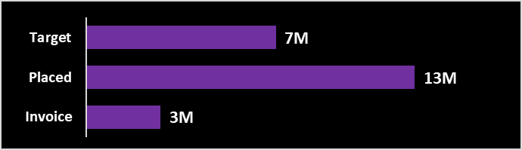
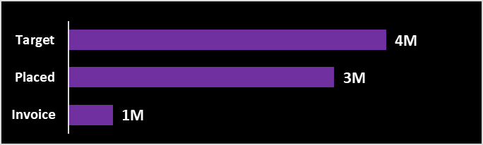
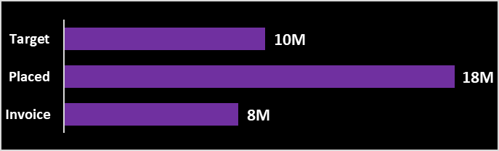
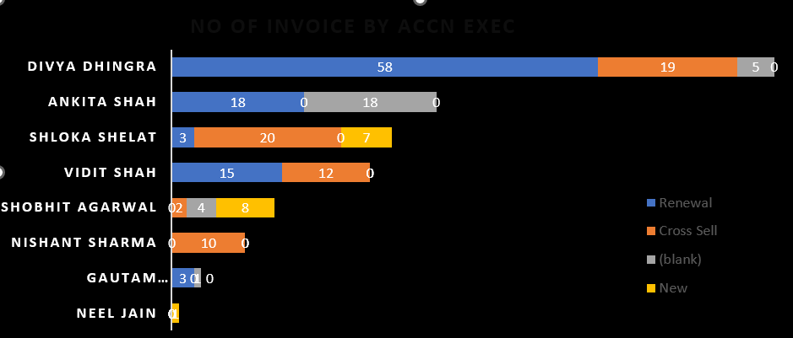
SUMMARY
CROSS SELL NEW | RENEWAL
NUMBER OF INVOICE BY ACCOUNT EXECUTIVE | NUMBER OF MEETINGS BY ACCOUNT EXECUTIVE

Slide 4
SUMMARY(Contd)
OPEN OPPORTUNITY BY -TOP 4 | OPPORTUNITY PRODUCT DISTRUBUTION
STAGE FUNNEL BY REVENUE | OPPORTUNITY BY REVENUE –TOP 4

Slide 5
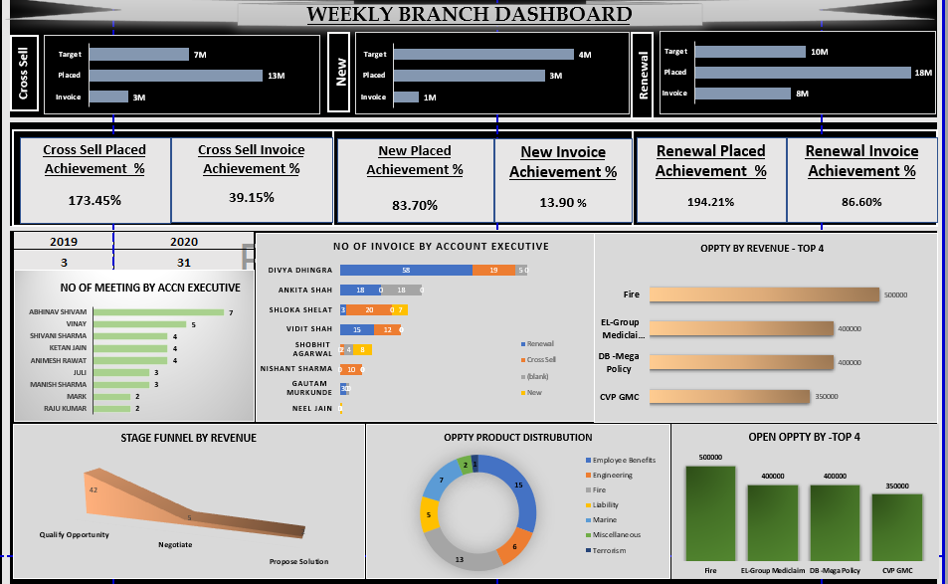
EXCEL DASHBOARD

Slide 6
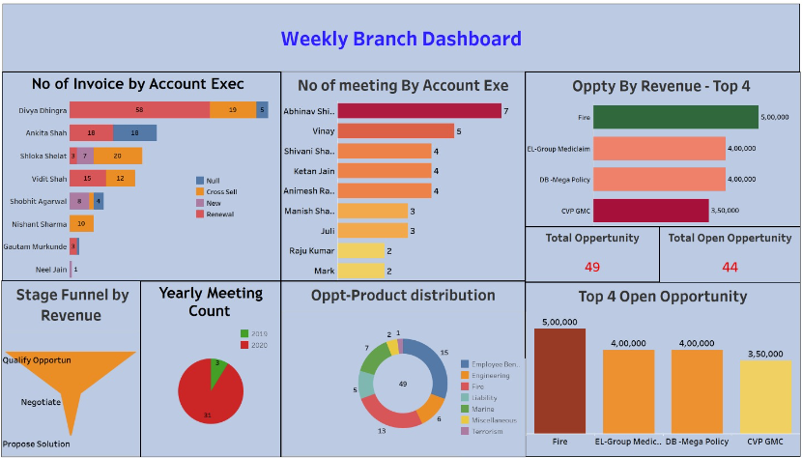
TABLEAU DASHBOARD

Slide 7
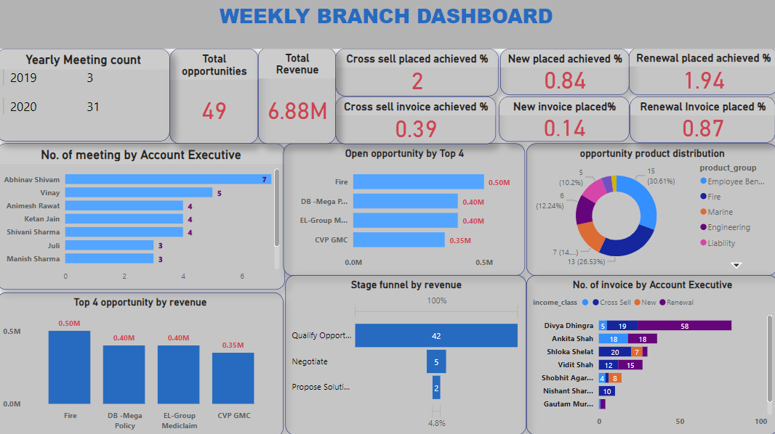
POWER BI DASHBOARD

Slide 8
CONCLUSION
The insights drawn from the analysis are as follows
Total revenue is 7M
Abhinav Shivam accounted for most number of meetings(7) by an account executive.
Divya Dhingra accounted for the most number of invoice by an account executive.
Total premium paid is 143M
The number of meetings in 2020 is 31 which is more than the meeting count in 2019.
Total opportunities is 49
The top 4 contributors of revenue in terms of open opportunity includes fire,EL Group Mediclaim,DB Mega Policy and CVP DMC.
The total number of clients is 204 while the total number of policies is 199.

